Slide 1
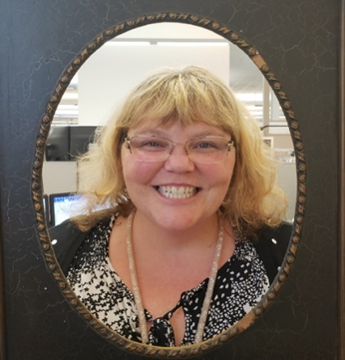
ODOT Pedestrian Safety Enforcement Operations
Heidi Manlove
ODOT- Transportation Safety Division
Pedestrian & Bicycle Safety and Safe Routes to School (SRTS) Program Manager
Heidi.Manlove@odot.state.or.us
Notes:
About me, Position, behavioral side of safety
Grant management- manage projects
Committees
Program management- HSP, federal reporting, Education

Slide 2

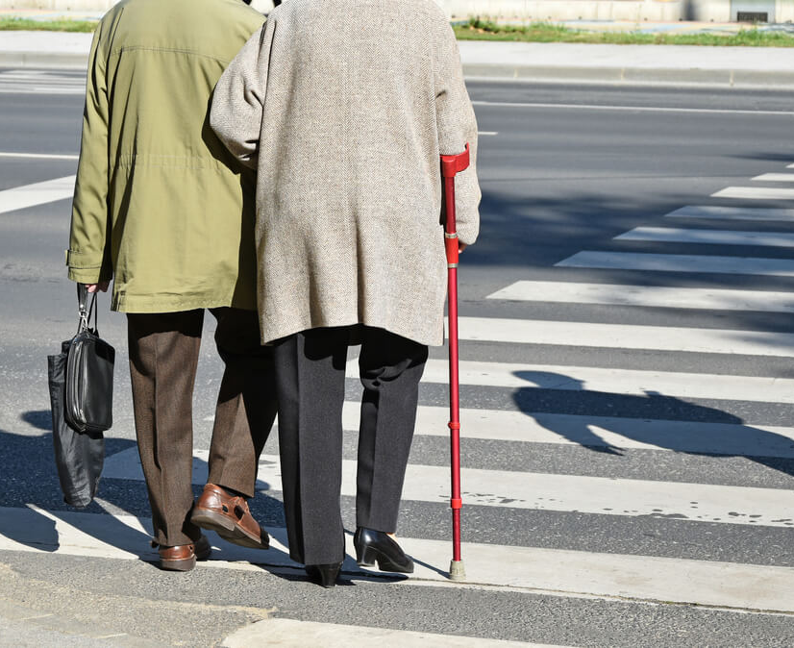
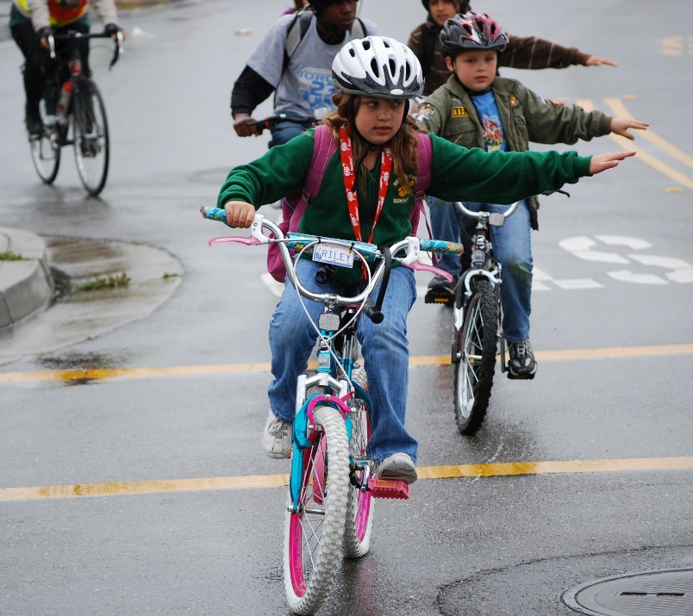
What I do at ODOT
Notes:
The ultimate goal of the program is to educate and bring awareness of best safe practices of behaviors for all road users with the aim for Oregon to have zero fatalities for pedestrians who walk or roll using conveyances such as wheelchairs and skateboards. The strategy to accomplish this is through a triangulated approach of collaborating and partnering with local stakeholders and agencies such as our overtime police enforcement pedestrian safety grants. Secondly, creating education materials to be used in safety projects and programming. The third part of the program approach is through the development and delivery of annual media safety campaigns. Pedestrian involved motor vehicle crashes are often due to multiple factors including road user behavior, roadway infrastructure or lack there of, roadway design, and other factors like time of day and lighting.

Slide 3
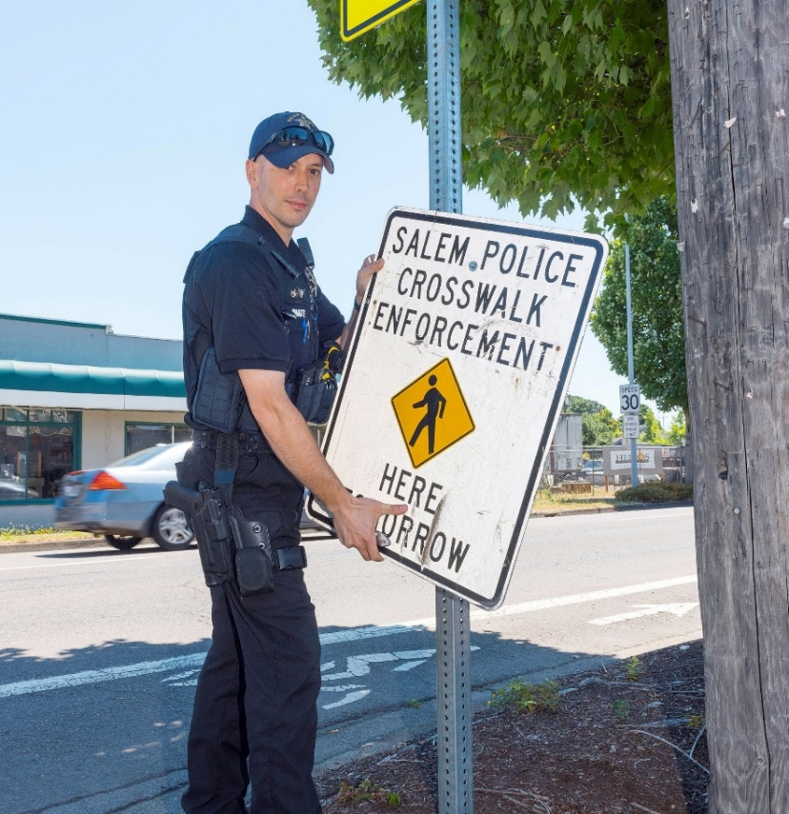
Why Invest in Pedestrian Safety Enforcement
Nationally and in Oregon
  17% of traffic fatalities is pedestrians
  2% bicyclist fatalities
5 year average
  74 Pedestrian Fatalities
  9 Bicyclist Fatalities
Notes:
Oregon pedestrians and bicyclists face numerous barriers to safe walking and rolling including crosswalk and intersection safety, motorists speeding in high pedestrian and bicyclist use areas including down-towns and school zones, infrastructure that lacks pedestrian and bicycle facilities, and lack of awareness or knowledge on the part of all road users regarding non-motorist safety laws best safety practices.
All road users (motorized and non-motorized) bear responsibility in non-motorist involved motor vehicle crashes, however, the non-motorist is most at risk for serious injury and fatality. Nearly half of pedestrian crashes occur in a crosswalk or an intersection, often where drivers fail to yield the right-of-way. The projected impact of focused HVE operations statewide is three fold: 1) to educate all road users on the safest behaviors for pedestrians and motorists, 2) to enforce Oregon transportation safety laws to encourage safe behaviors from all road users, and 3) decrease pedestrian and motorist conflicts particularly at crosswalks and intersections and ultimately decrease non-motorist's serious injuries and fatalities.

Slide 4
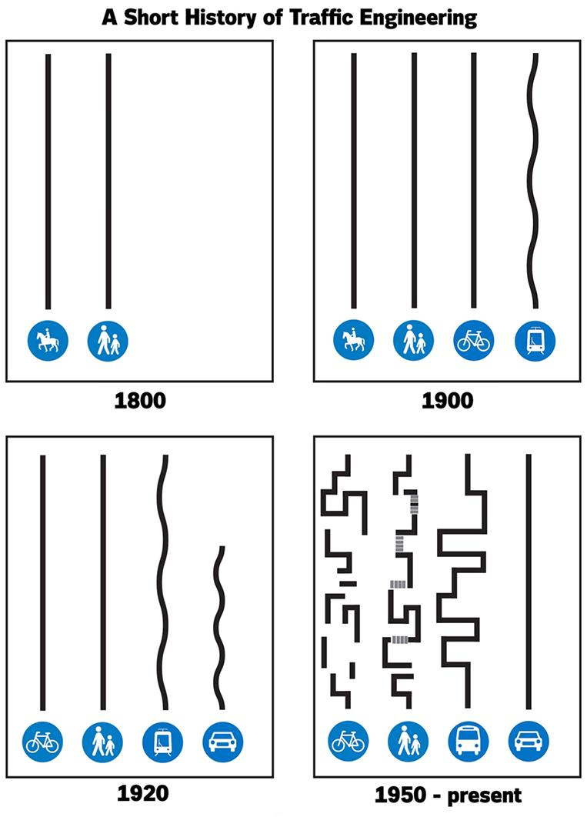
Notes:
Before we jump into specific infrastructure, I wanted to talk about this diagram which breaks down our roadway systems.
As a person driving a car, you get a straight line meaning the system is connected. Meaning you get more options to get where you need to go.
For people who are riding bicycles you can see how fragmented their system is. The bike lane is there and poof on the other side of the intersection it is gone. This lack of continuity in the infrastructure can often explain why people riding bicycles make decisions like riding the wrong way down the road. Yes that person is doing it wrong, however there might not be a better way for that person to get to where they need to go. They have fewer options.
To be a friendly driver, understand the challenges of getting around in a disjointed system and be prepared to respond safely to that behavior.
There are resources going into roads where bicycle traffic is prioritized and roads where car traffic is prioritized. This helps keep people riding bikes off of roads with lots of car traffic.

Slide 5
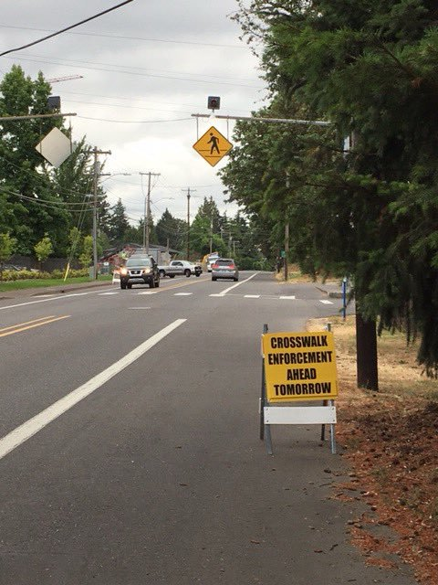
Investing in Pedestrian Enforcement Operations
Oregon ranks 19th in the nation for pedestrian fatality rate
While some types of crashes have decreased, pedestrian crashes have increased
Over-represented in the Data
Notes:
In Oregon, 932 pedestrian injuries in 2018 accounted for 2 percent of all Oregon traffic injuries during the year (preliminary data and subject to change). The 79 pedestrian fatalities in 2018 (ODOT Crash Analysis & Reporting, or CARS) accounted for 18 percent of all Oregon traffic fatalities.
For the 2016-2018, fatal and serious injury crashes involving pedestrians showed that an average of 43 percent were coded as driver error, and an average of 59 percent were coded as pedestrian error.
For the 2016-2018, the top driver errors in pedestrian-involved fatal and serious injury crashes was failure to yield right of way to the pedestrian, lane departure, speeding, and reckless driving.
For the 2016-2018, the top pedestrian errors in fatal and serious injury pedestrian-involved crashes were crossing between intersections, standing or lying in roadway, not yielding the right of way, and disregarding a traffic signal.
For the 2016-2018, an average 81 percent of crashes involving at least 1 pedestrian fatality occurred in the dark.
Based on the program area problem identification for Oregon, pedestrian and bicyclist injuries and fatalities consistently represent a disproportionate percentage of overall traffic injuries and deaths with a combined total of 19% of the overall state MVC fatality data. To decrease this percentage, Oregon has set the performance targets to decrease pedestrian and bicyclist fatalities from the moving average. To accomplish this Oregon has planned to use the countermeasure strategy of HVE for Non-Motorized operations to invest in education and awareness of Oregon state laws and best practices for all road users to decrease risk for vulnerable non-motorized road users.

Slide 6
2014-2018 Bicyclists in MVCs in Oregon
Source: Crash Analysis Reporting Unit, Oregon Department of Transportation
*Fatality Analysis Reporting System Data, FARS, NHTSA

Slide 7
2014-2018
Pedestrian Crashes in MVCs in Oregon

Slide 8

Digital Toolkit for LEAs to use for Social Media
ODOT Pedestrian and Bicycle Digital Tool-Kit

Slide 9
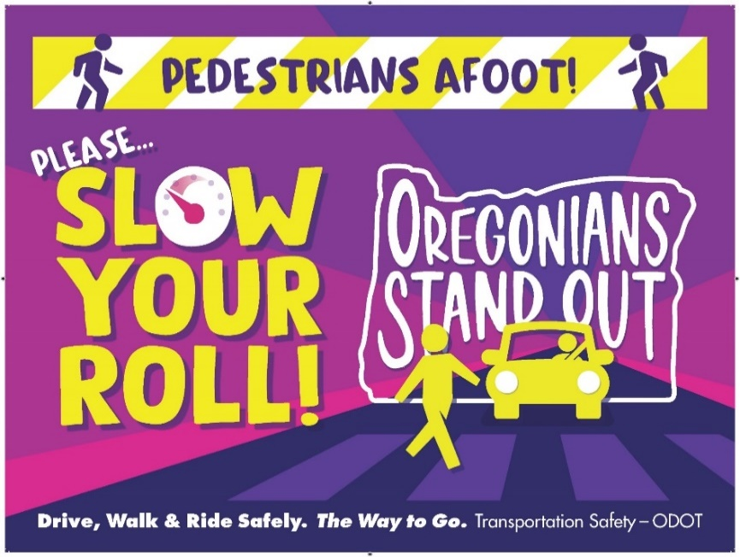
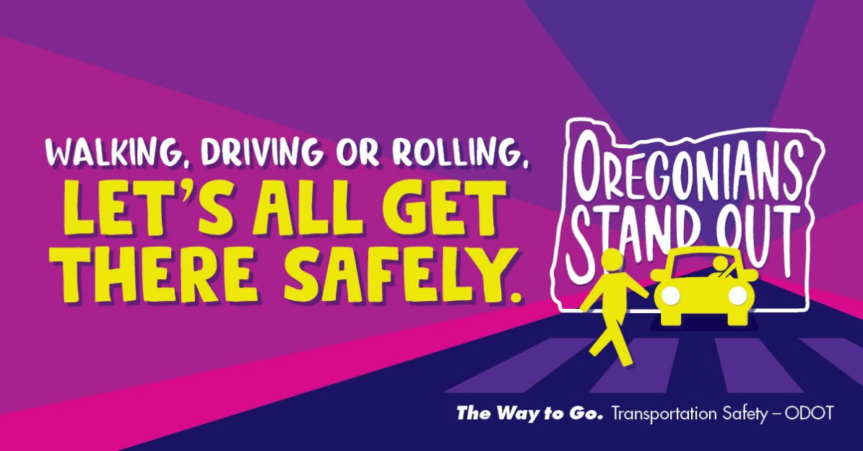
Pedestrian Campaigns

Slide 10

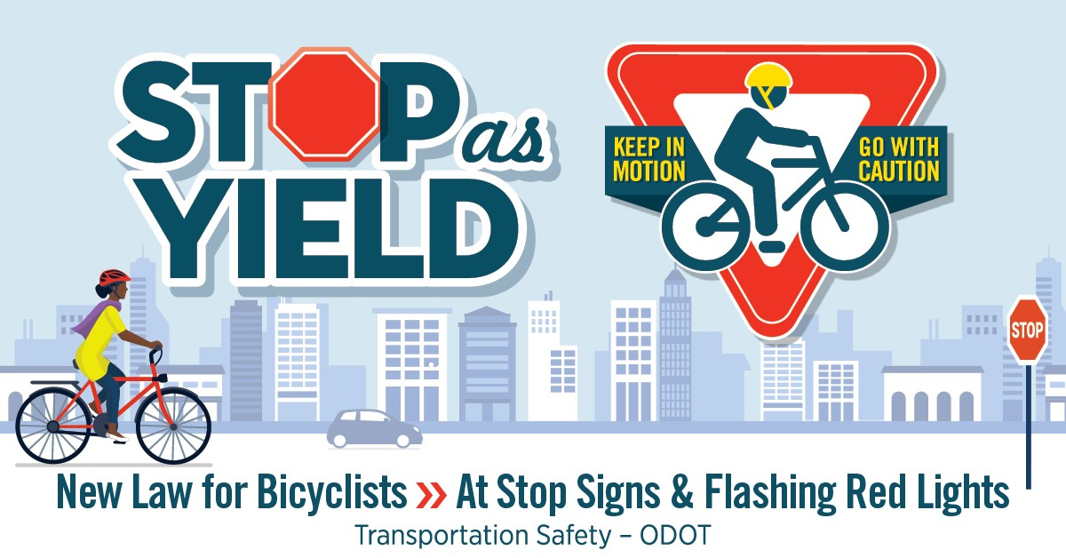
Bicycle Safety Campaigns

Slide 11
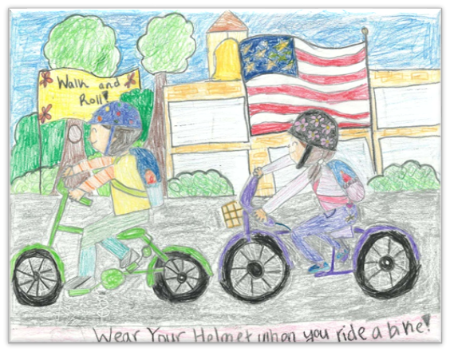
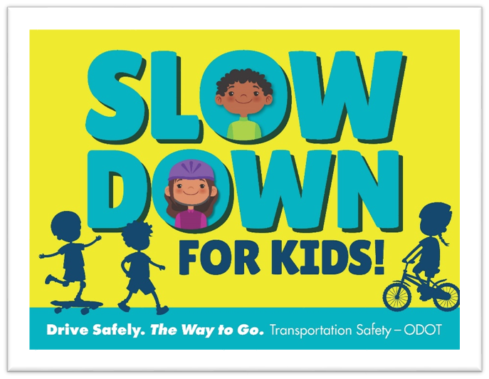
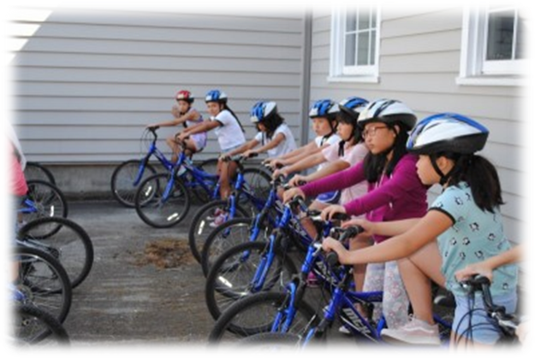
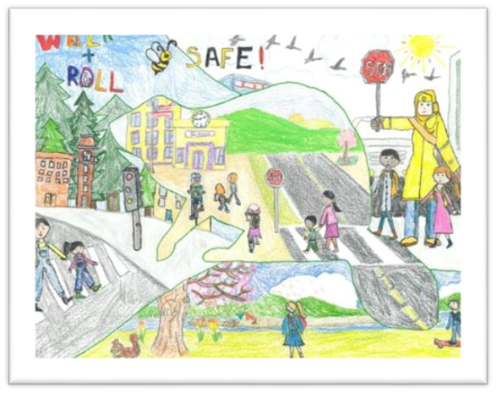
Safe Routes to School

Slide 12


Pedestrian and Driver Safety Education Materials

Slide 13
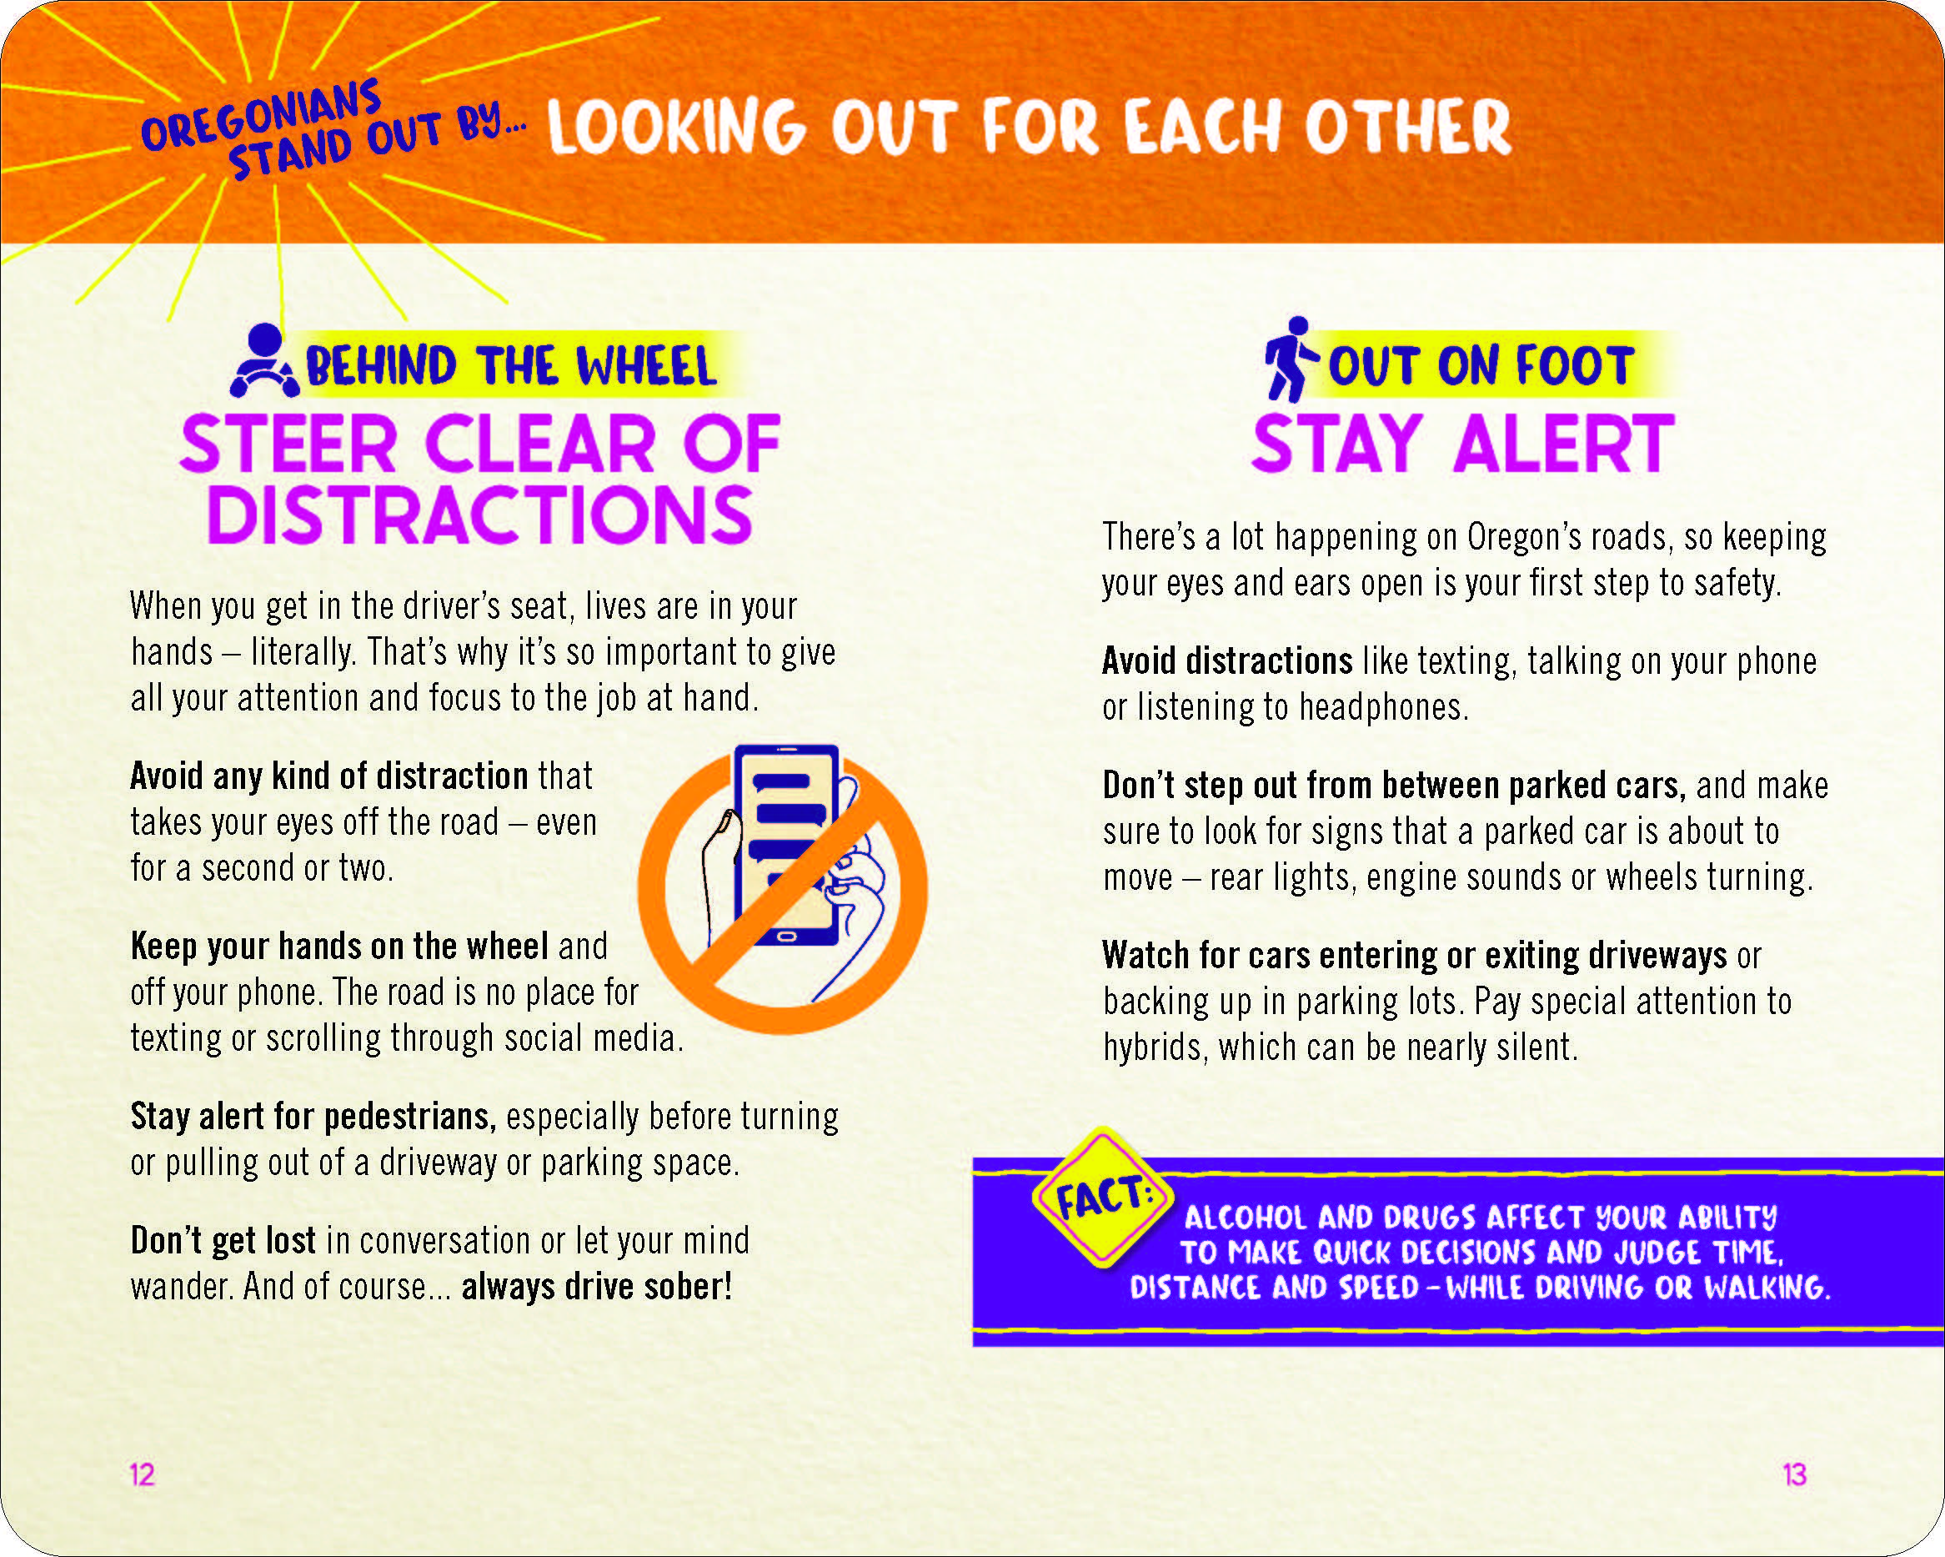
Education Materials

Slide 14
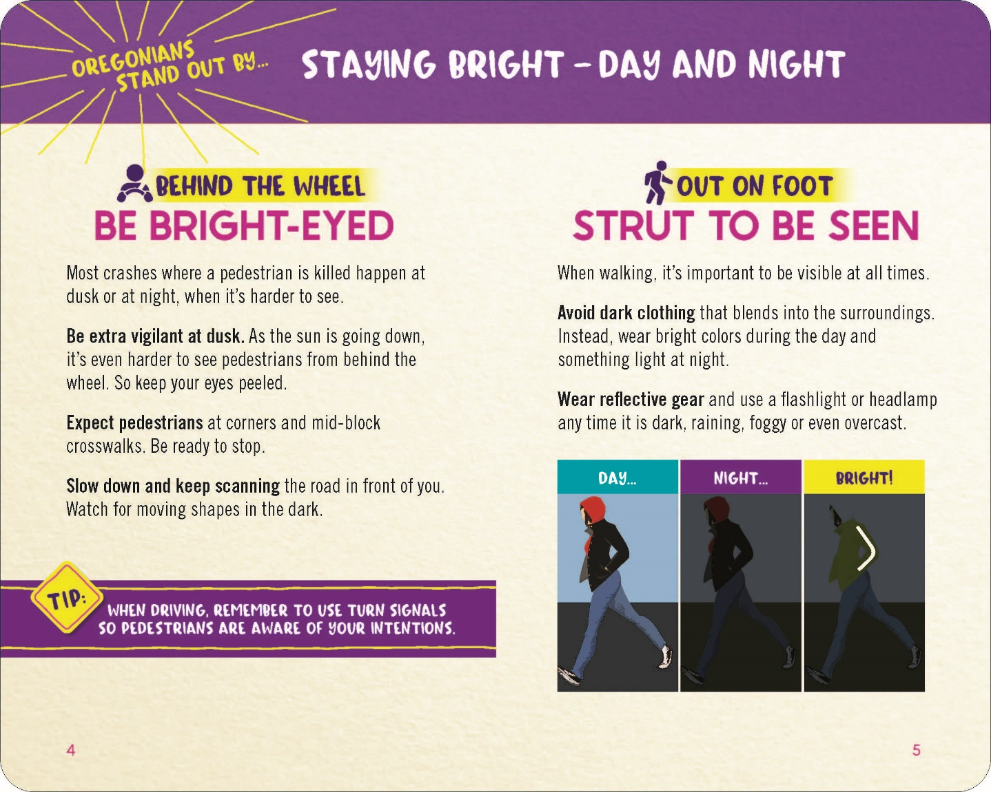
Education Materials

Slide 15
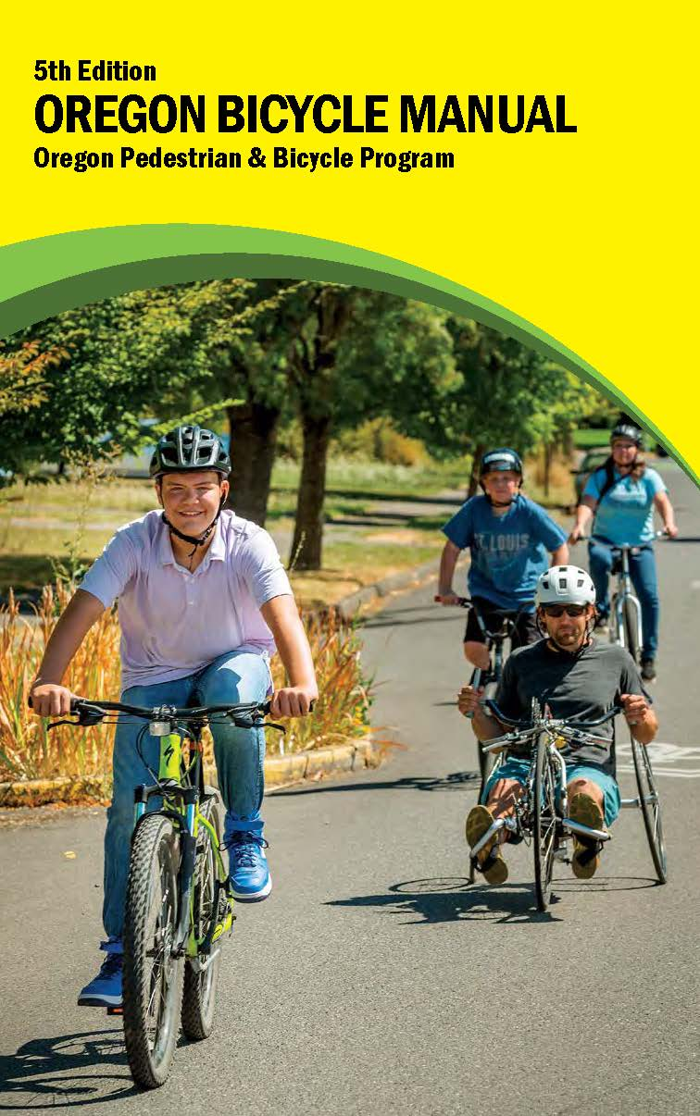
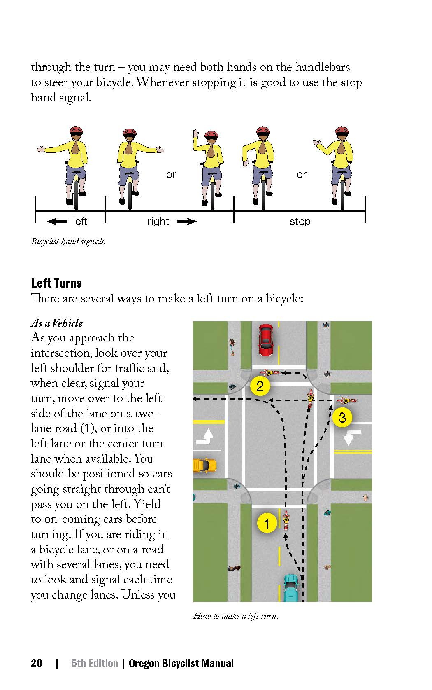
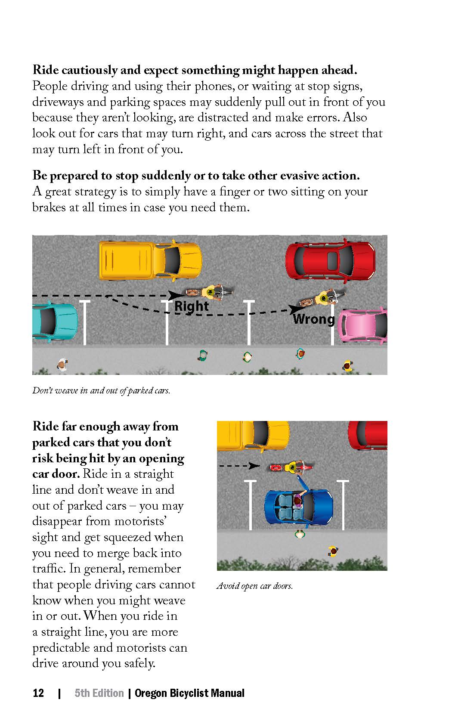
Bicycle Safety Education Materials

Slide 16
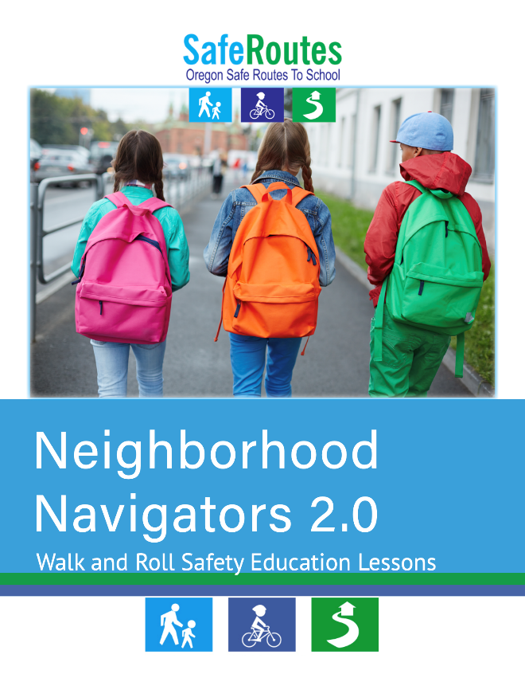


Safe Routes to School Education Materials

Slide 17
https://www.oregon.gov/odot/Safety/Documents/OregonBikePedDriverRules.pdf
https://www.oregon.gov/odot/Safety/Documents/OregonCrosswalkLawsENG.pdf
https://www.oregon.gov/odot/Safety/Documents/SafeBikingForKidsBooklet.pdf

Slide 18


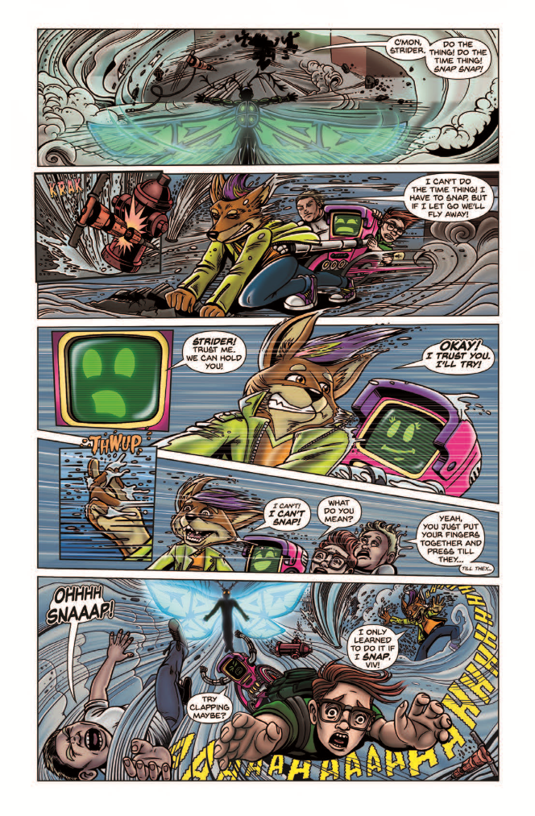
Safe Routes to School Comic Books

Slide 19

ODOT PSA
Notes:
Both English and Spanish

Slide 20
Safe Routes to School PSA

Slide 21
Bicycle Safety PSA

Slide 22
ODOT Pedestrian Safety Enforcement Operations
Heidi Manlove
ODOT- Transportation Safety Division
Pedestrian & Bicycle Safety and Safe Routes to School (SRTS) Program Manager
Heidi.Manlove@odot.state.or.us
Notes:
About me, Position, behavioral side of safety
Grant management- manage projects
Committees
Program management- HSP, federal reporting, Education

